Slide 1

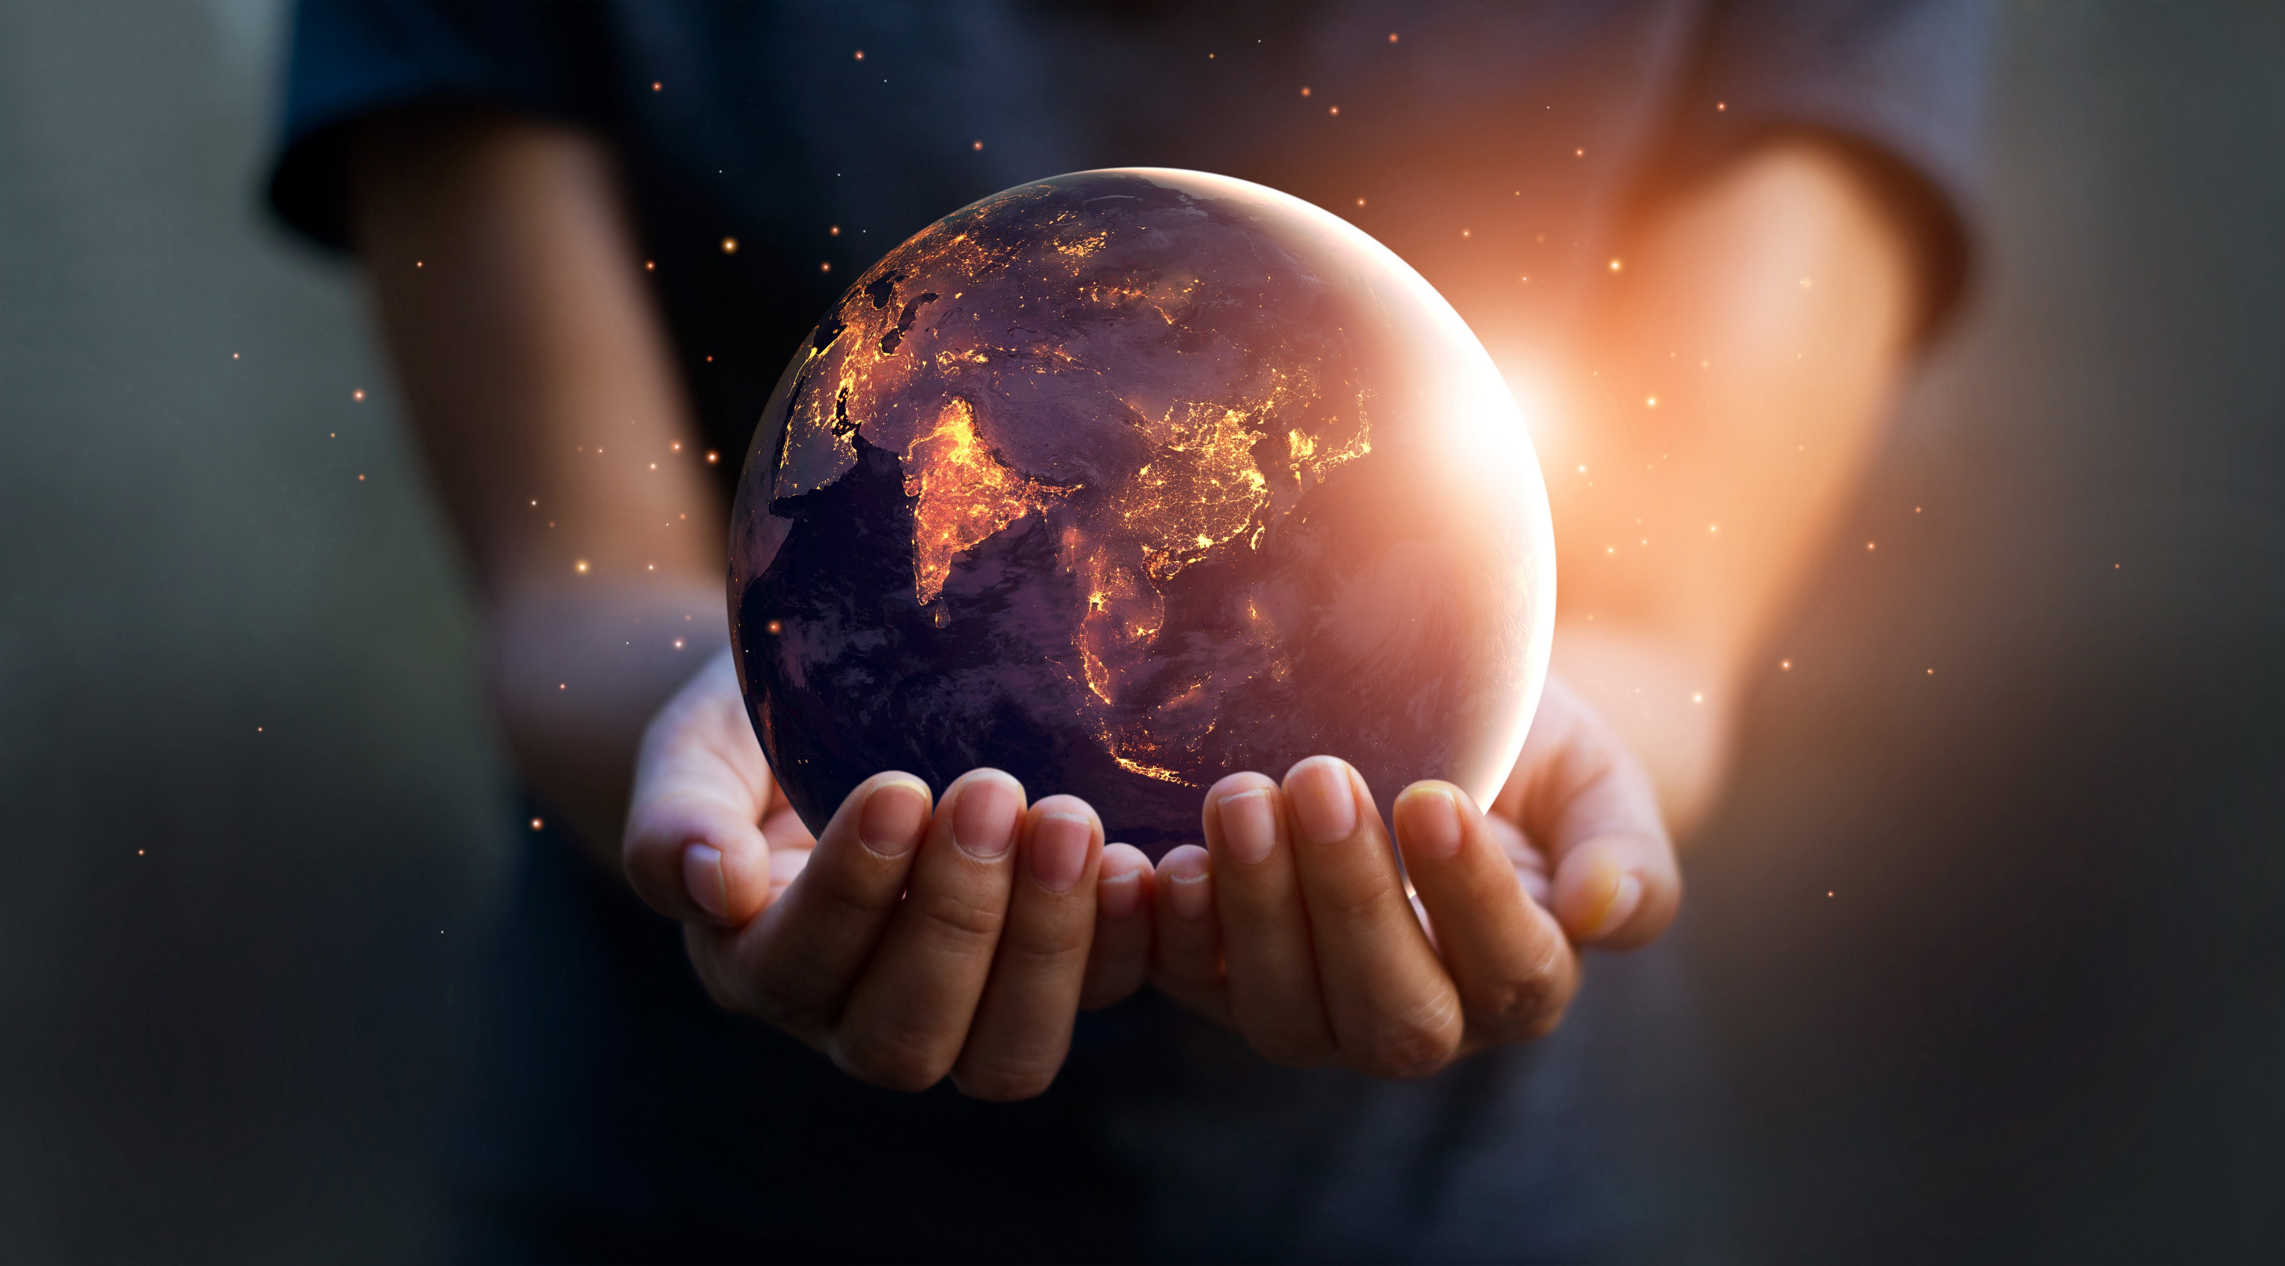
Spacepic
How many images?
#
Generate
Download all
1
2
3
Download
Download
Download
4
5
Download
Download

